Slide 1
A Timeline of AI Evolution: Key Milestones, Effects, and Transformative Transitions
Exploring AI's history and its impact on society
Notes:
Generated by Copilot This timeline highlights the key milestones in AI's evolution, emphasizing how each phase has transformed society. We'll explore the origins, breakthroughs, and the profound effects AI has had on various sectors, setting the stage for understanding its ongoing impact and future potential. ______
Generated by Copilot This timeline highlights the key milestones in AI's evolution, emphasizing how each phase has transformed society. We'll explore the origins, breakthroughs, and the profound effects AI has had on various sectors, setting the stage for understanding its ongoing impact and future potential. ______
AI-generated content may be incorrect. --- This presentation explores the fascinating journey of artificial intelligence, highlighting its foundational concepts, key historical milestones, societal impacts, and the transformative trends shaping its future.

Slide 2
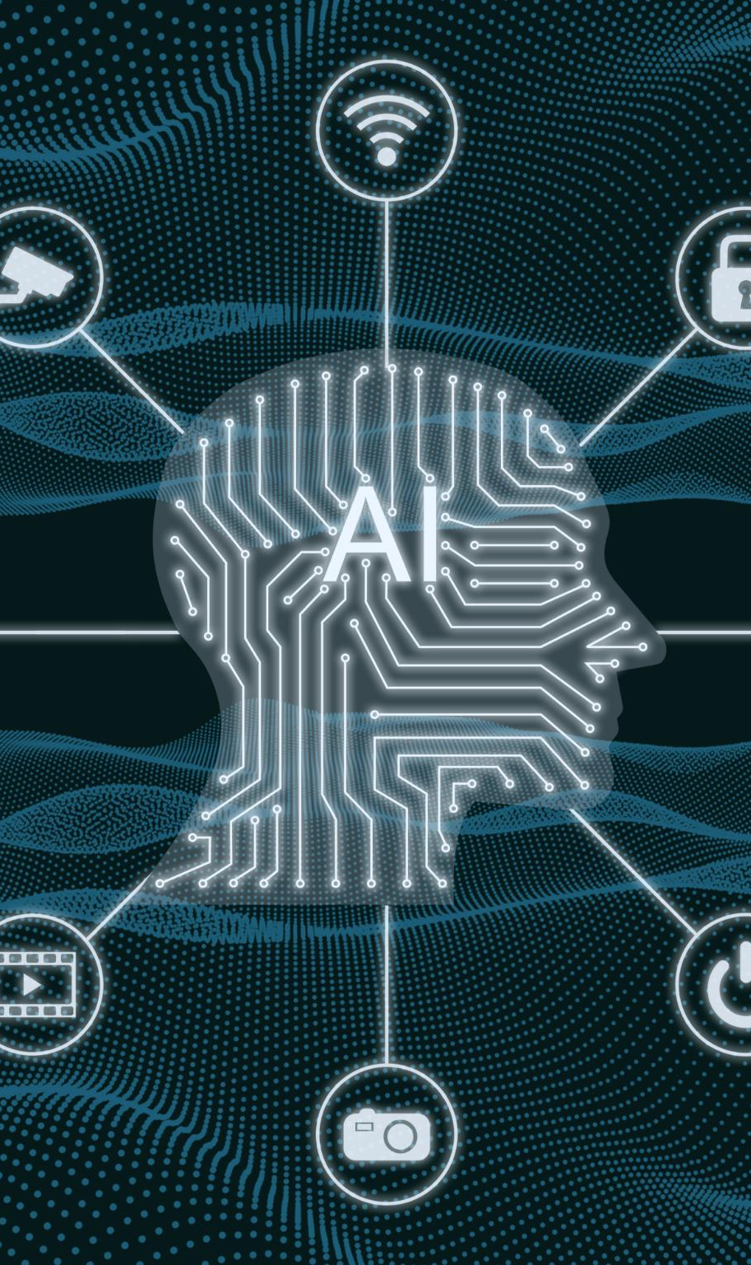
Agenda
Foundations of Artificial Intelligence
Growth and Challenges: 1960s to 1980s
Modern Breakthroughs: 1990s to 2010s
Social and Economic Effects of AI Evolution
Current Trends and Future Transitions
Notes:
Generated by Copilot The agenda outlines our journey through AI's history, starting with foundational growth and challenges from the 1960s to 1980s, moving through modern breakthroughs in the 1990s to 2010s, examining social and economic impacts, and concluding with current trends and future transitions. This structure will help us grasp AI's comprehensive development. ______
Generated by Copilot The agenda outlines our journey through AI's history, starting with foundational growth and challenges from the 1960s to 1980s, moving through modern breakthroughs in the 1990s to 2010s, examining social and economic effects, and concluding with current trends and future transitions. This structure will help us grasp AI's comprehensive development. ______
--- We will cover the origins and foundations of AI, examine its growth and challenges from the 1960s to 1980s, review modern breakthroughs from the 1990s to 2010s, discuss the social and economic effects of AI, and conclude with current trends and future transitions in AI technology. Image source: Microsoft 365 content library

Slide 3
Foundations of Artificial Intelligence
Notes:
Generated by Copilot This section focuses on the foundational period of AI, where early theories and concepts were established. Although the slide lacks text, it sets the context for understanding the initial ideas and groundwork that shaped AI research and development in its infancy. ______
Generated by Copilot This section focuses on the foundational period of AI, where early theories and concepts were established. Although the slide lacks text, it sets the context for understanding the initial ideas and groundwork that shaped AI research and development in its infancy. ______
Understanding the foundations of AI helps us appreciate the early ideas and innovations that paved the way for modern AI, including seminal theories, tests, and the creation of initial programs.

Slide 4
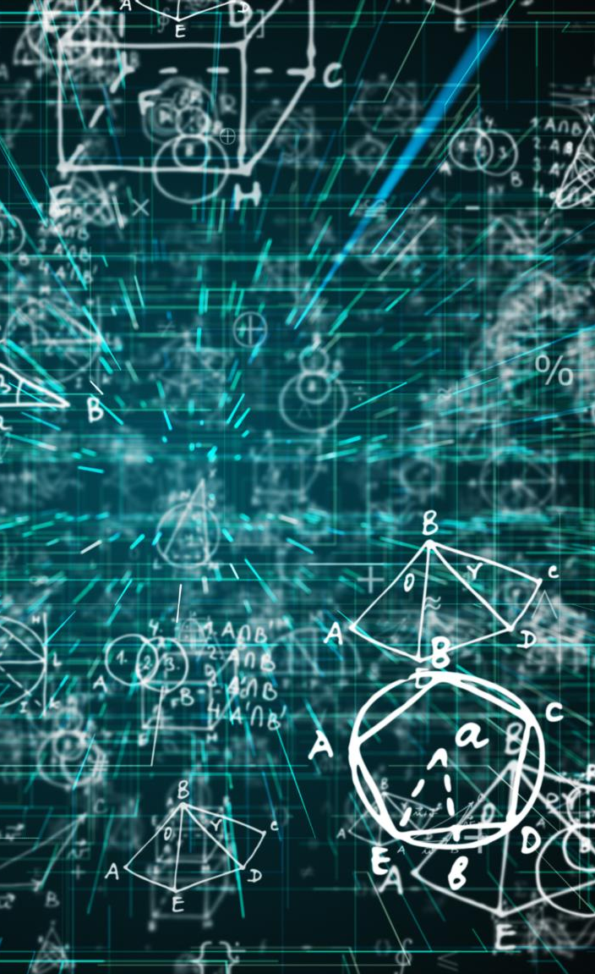
Early Concepts and Mathematical Groundwork
Mathematical Logic Foundations
Mathematical logic provides the essential framework for formal reasoning used in early AI development.
Formal Reasoning Principles
Formal reasoning methods enable machines to process and deduce information logically and systematically.
Early Computational Theories
Computational theories laid the groundwork for machines capable of performing intelligent tasks.
Notes:
Generated by Copilot Mathematical logic formed the backbone of early AI, providing a formal framework for machines to reason systematically. Early computational theories introduced concepts that enabled machines to perform intelligent tasks, laying the essential groundwork for AI's development as a scientific discipline. ______
Generated by Copilot Mathematical logic formed the backbone of early AI, providing a formal framework for machines to reason systematically. Early computational theories introduced concepts that enabled machines to perform intelligent tasks, laying the essential groundwork for AI's development as a scientific discipline. ______
--- The origins of AI are rooted in mathematical logic, formal reasoning, and early computational theories. These foundational ideas set the stage for developing machines capable of intelligent behavior. Image source: Microsoft 365 content library

Slide 5
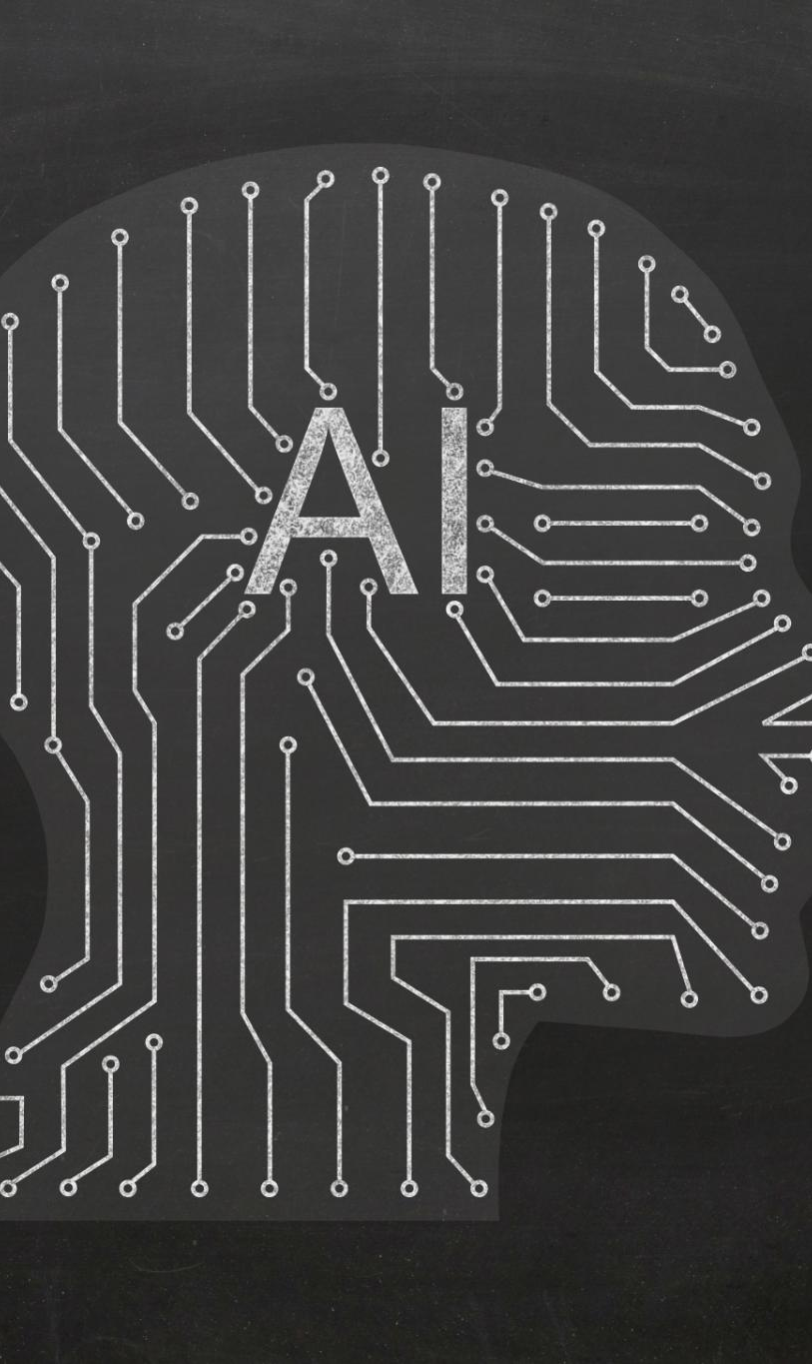
The Turing Test and Alan Turing’s Influence
Turing Test Concept
The Turing Test evaluates a machine's ability to exhibit intelligent behavior indistinguishable from a human.
Impact on AI Research
Turing’s test significantly shaped AI research by setting a foundational goal for machine intelligence development.
Philosophical Implications
The test raises fundamental questions about cognition, consciousness, and the nature of thinking machines.
Notes:
Generated by Copilot Alan Turing's work, especially the Turing Test, was pivotal in defining machine intelligence. The test challenges whether a machine can mimic human behavior convincingly, influencing AI research goals and sparking philosophical debates about cognition and consciousness in machines. ______
Generated by Copilot Alan Turing's work, especially the Turing Test, was pivotal in defining machine intelligence. The test challenges whether a machine can mimic human behavior convincingly, raising deep philosophical questions about cognition and consciousness that continue to influence AI research and ethical considerations today. ______
--- Alan Turing proposed the famous Turing Test as a criterion for machine intelligence, influencing the direction of AI research and raising fundamental questions about thinking machines. Image source: Microsoft 365 content library

Slide 6

Creation of the First AI Programs in the 1950s
Early AI Programming
The 1950s marked the creation of the first AI programs capable of executing tasks like game playing and problem-solving.
Practical AI Experimentation
This era initiated practical experiments in artificial intelligence, laying the foundation for future AI advancements.
Notes:
Generated by Copilot The 1950s saw the creation of the first AI programs capable of tasks like game playing and problem-solving. These early experiments were crucial in demonstrating AI's potential and set the foundation for more complex developments in the decades that followed. ______
Generated by Copilot The 1950s saw the creation of the first AI programs capable of tasks like game playing and problem-solving. These early experiments were crucial in demonstrating AI's potential and set the foundation for more complex developments in the decades that followed. ______
--- The 1950s saw the development of the first AI programs that could perform tasks such as problem-solving and game playing, marking the beginning of practical AI experimentation. Image source: Microsoft 365 content library

Slide 7
Growth and Challenges: 1960s to 1980s
Notes:
Generated by Copilot This period covers AI's growth and the challenges it faced from the 1960s to 1980s. Although the slide lacks detailed text, it introduces a critical era marked by both progress and obstacles that shaped the trajectory of AI research. ______
Generated by Copilot This period covers the growth and challenges AI faced from the 1960s to 1980s. It was marked by significant progress but also setbacks, including limitations in computational power and overly optimistic expectations that led to periods of reduced enthusiasm and funding. ______
This era witnessed advances in symbolic AI and expert systems, but also faced significant setbacks known as the AI Winter, followed by renewed interest through emerging machine learning methods.

Slide 8

Development of Symbolic AI and Expert Systems
Symbolic Reasoning
Symbolic reasoning involves manipulating symbols to mimic human logical thought processes in AI research.
Expert Systems
Expert systems emulate human decision-making by applying rules within specific knowledge domains.
Commercial Applications
Symbolic AI and expert systems led to practical commercial applications in various industries.
Notes:
Generated by Copilot Symbolic AI focused on manipulating symbols to replicate human logical reasoning, while expert systems applied rule-based knowledge to make decisions in specific domains. These approaches led to practical applications in industries, marking a significant step in AI's commercial use. ______
Generated by Copilot Symbolic AI and expert systems emerged as key developments, using symbolic reasoning to replicate human logic and decision-making within specific domains. These systems found practical commercial applications, demonstrating AI's value in real-world problem-solving during this era. ______
--- Research focused on symbolic reasoning and building expert systems that could emulate human decision-making in specific domains, leading to commercial applications. Image source: Microsoft 365 content library

Slide 9

The First AI Winter: Causes and Consequences
Overly Optimistic Expectations
Initial AI promises exceeded capabilities, leading to disappointment and reduced enthusiasm.
Limited Computational Resources
Hardware constraints restricted AI progress during early development phases.
Impact on Funding and Perception
Reduced investment and negative public perception slowed research and innovation in AI.
Notes:
Generated by Copilot The first AI winter resulted from overly optimistic expectations that AI could quickly solve complex problems, combined with limited computational resources. This led to reduced funding and skepticism, slowing AI research and innovation during this challenging period. ______
Generated by Copilot The first AI winter resulted from inflated expectations and limited hardware capabilities, causing disappointment and a decline in funding. This slowdown impacted research momentum and public perception, highlighting the challenges of aligning AI ambitions with technological realities. ______
--- Due to overly optimistic expectations and limited computational resources, AI development slowed dramatically during the AI Winter, impacting funding and public perception. Image source: Microsoft 365 content library

Slide 10
Renewed Interest: Emergence of Machine Learning Concepts
AI Resurgence in 1980s
The late 1980s marked a revitalization of artificial intelligence research through new machine learning methods.
Focus on Data and Patterns
Machine learning approaches centered on analyzing data and recognizing patterns to improve AI capabilities.
Research Momentum Boost
This resurgence brought renewed momentum to AI research, paving the way for future advancements.
Notes:
Generated by Copilot The late 1980s revitalized AI research through the emergence of machine learning, which emphasized data analysis and pattern recognition. This shift renewed momentum in AI development, setting the stage for future breakthroughs by focusing on learning from data rather than relying solely on programmed rules. ______
Generated by Copilot The late 1980s brought renewed interest in AI through machine learning, focusing on data analysis and pattern recognition. This shift revitalized research efforts and laid the groundwork for the data-driven approaches that dominate AI today. ______
--- The late 1980s saw a resurgence of AI driven by machine learning approaches focusing on data and pattern recognition, revitalizing research momentum. Image source: Microsoft 365 content library

Slide 11
Modern Breakthroughs: 1990s to 2010s
Notes:
Generated by Copilot This section introduces the era of modern breakthroughs from the 1990s to 2010s, a time when AI made significant advances. Although the slide lacks text, it signals a transition to more data-driven and sophisticated AI techniques that transformed the field. ______
Generated by Copilot This section introduces the modern breakthroughs from the 1990s to 2010s, a transformative era where AI advanced significantly through new techniques and applications, setting the stage for today's AI capabilities. ______
AI experienced major advancements in data-driven approaches, neural networks, and landmark achievements, setting the stage for its current transformative role in society.

Slide 12

Rise of Data-Driven AI and Neural Networks
Large Datasets Availability
Access to large datasets has been crucial in training neural networks effectively to improve AI performance.
Improved Algorithms
Advanced algorithms have enhanced the capabilities of neural networks to solve complex problems accurately.
Enhanced AI Accuracy
Data-driven neural networks enabled AI systems to achieve higher accuracy in various applications.
Notes:
Generated by Copilot Access to large datasets and improved algorithms enabled neural networks to perform complex tasks with greater accuracy. This data-driven approach significantly enhanced AI's capabilities, allowing it to excel in areas like image and speech recognition. ______
Generated by Copilot Access to large datasets and improved algorithms enabled neural networks to excel, significantly enhancing AI's accuracy and effectiveness. This data-driven approach became central to AI's success in solving complex problems across various fields. ______
--- The availability of large datasets and improved algorithms enabled neural networks to flourish, allowing AI to solve complex problems with greater accuracy. Image source: Microsoft 365 content library

Slide 13
Landmark Achievements: Deep Blue, Watson, and AlphaGo
Deep Blue's Chess Victory
Deep Blue was a pioneering AI system that defeated a world chess champion, marking a major milestone in AI development.
Watson on Jeopardy!
Watson won the game show Jeopardy!, showcasing AI’s advanced natural language processing and information retrieval abilities.
AlphaGo's Game Mastery
AlphaGo mastered the complex board game Go, demonstrating the power of AI in strategic thinking and learning.
Notes:
Generated by Copilot Landmark AI achievements include Deep Blue's chess victory, demonstrating strategic computation; Watson's Jeopardy! win, showcasing natural language processing; and AlphaGo's mastery of Go, highlighting advanced learning and decision-making. These milestones illustrate AI's growing sophistication. ______
Generated by Copilot Landmark AI achievements like Deep Blue's chess victory, Watson's Jeopardy! win, and AlphaGo's mastery of Go demonstrate AI's growing sophistication. These milestones showcase AI's ability to handle complex strategic thinking and natural language understanding, marking major progress in the field. ______
--- Notable AI milestones include Deep Blue defeating a chess champion, Watson winning on Jeopardy!, and AlphaGo mastering the game of Go, demonstrating AI's growing capabilities. Image source: Microsoft 365 content library

Slide 14
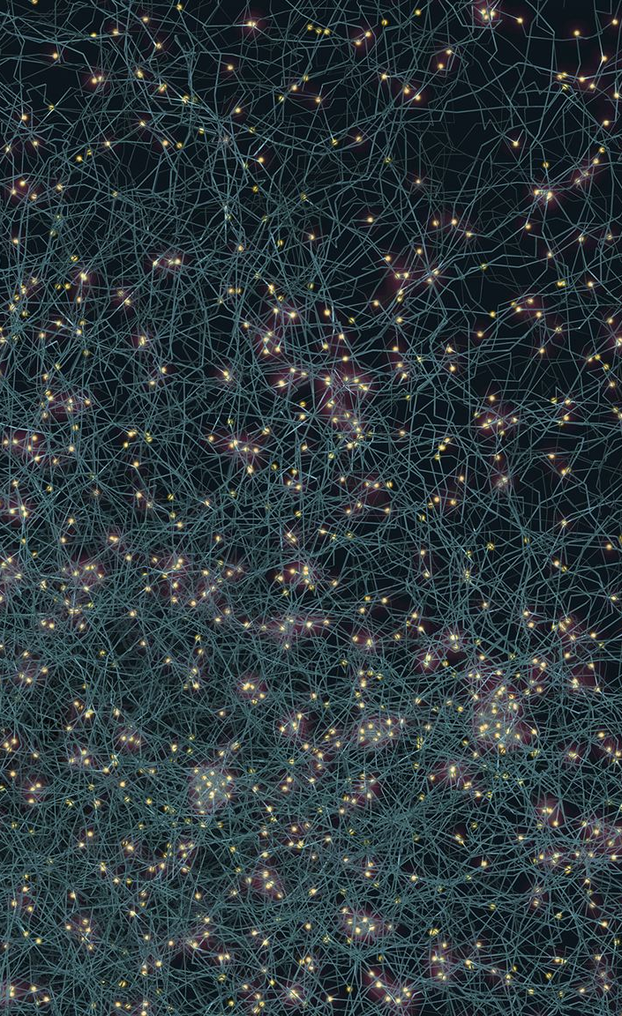
Transition to Deep Learning and Big Data
Deep Learning Techniques
Deep learning methods leverage neural networks to enhance AI’s ability to learn from complex data patterns.
Big Data Integration
Big data provides vast datasets that fuel training of deep learning models for improved accuracy and insights.
AI Applications
Deep learning and big data power applications like image recognition and natural language processing.
Notes:
Generated by Copilot Deep learning techniques leverage layered neural networks to identify complex patterns, while big data provides the vast information needed to train these models effectively. Together, they power applications such as image recognition and natural language processing, driving AI's current capabilities. ______
Generated by Copilot The transition to deep learning and big data integration revolutionized AI by enabling models to learn from vast, complex datasets. This advancement powers applications such as image recognition and natural language processing, driving AI's current capabilities and expanding its impact. ______
--- Deep learning techniques combined with big data and powerful computing transformed AI performance, powering applications from image recognition to natural language processing. Image source: Microsoft 365 content library

Slide 15
Social and Economic Effects of AI Evolution
Notes:
Generated by Copilot This section addresses the broad social and economic impacts of AI's evolution. It sets the stage for discussing how AI influences workforce dynamics, industry transformations, ethical considerations, and the future landscape shaped by these technologies. ______
Generated by Copilot This section addresses the broad social and economic effects of AI's evolution, including how AI technologies are reshaping industries, workforce dynamics, and societal structures, highlighting both opportunities and challenges. ______
As AI technologies matured, they began to significantly impact workforces, industries, daily life, and raised important ethical and societal questions.

Slide 16
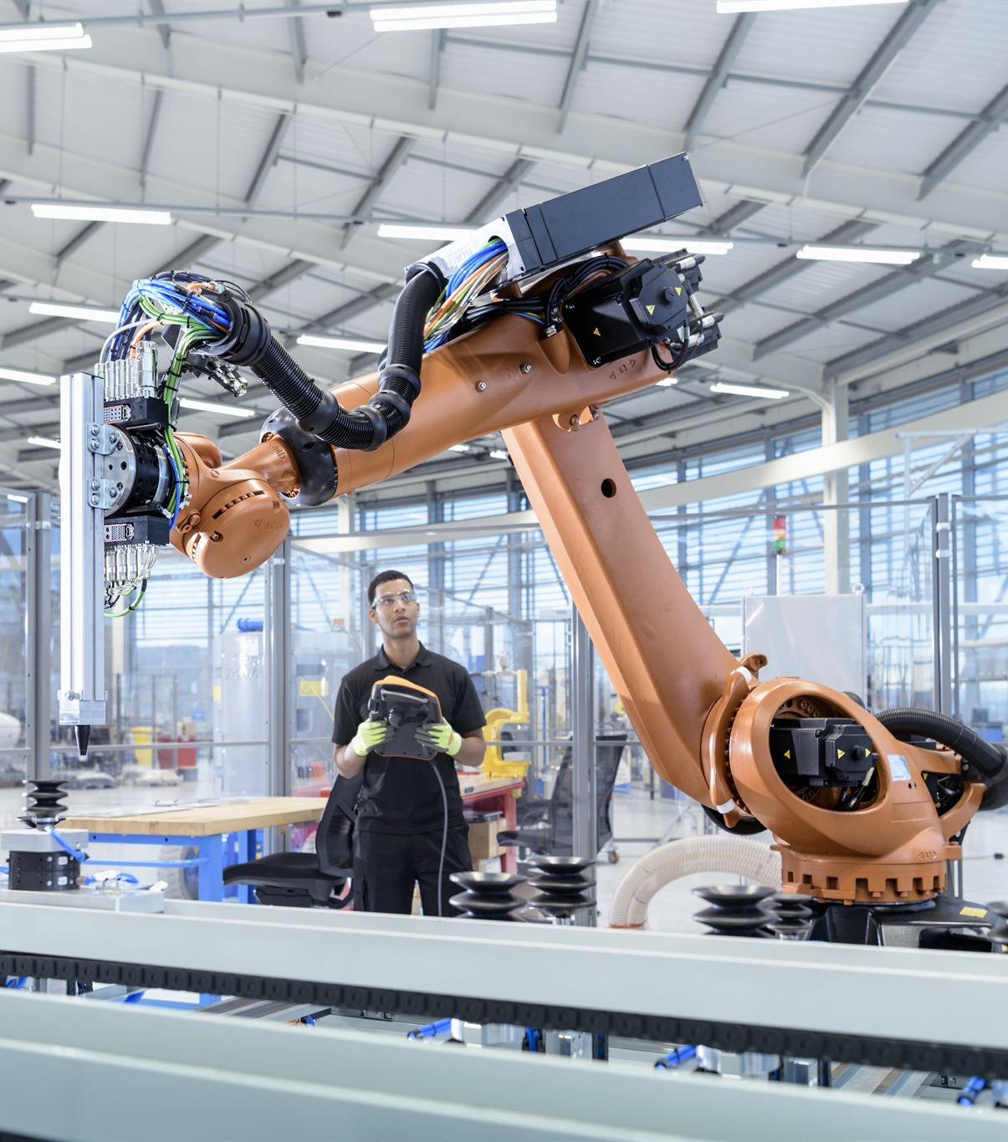
Impact on Workforce and Automation
Efficiency Through Automation
AI-driven automation enhances productivity by streamlining repetitive tasks and improving operational efficiency.
Workforce Displacement Concerns
Automation raises concerns about job displacement and the need for reskilling and workforce adaptation.
Notes:
Generated by Copilot AI-driven automation boosts efficiency by handling repetitive tasks, but it also raises concerns about job displacement. This dual impact highlights the importance of reskilling and adapting the workforce to coexist with advancing AI technologies. ______
Generated by Copilot AI-driven automation boosts efficiency by handling repetitive tasks, but it also raises concerns about job displacement. This dual impact underscores the importance of workforce reskilling and adapting to new roles in an AI-enhanced economy. ______
--- AI-driven automation has changed the nature of jobs, creating efficiencies but also raising concerns about displacement and the need for workforce adaptation. Image source: Microsoft 365 content library

Slide 17
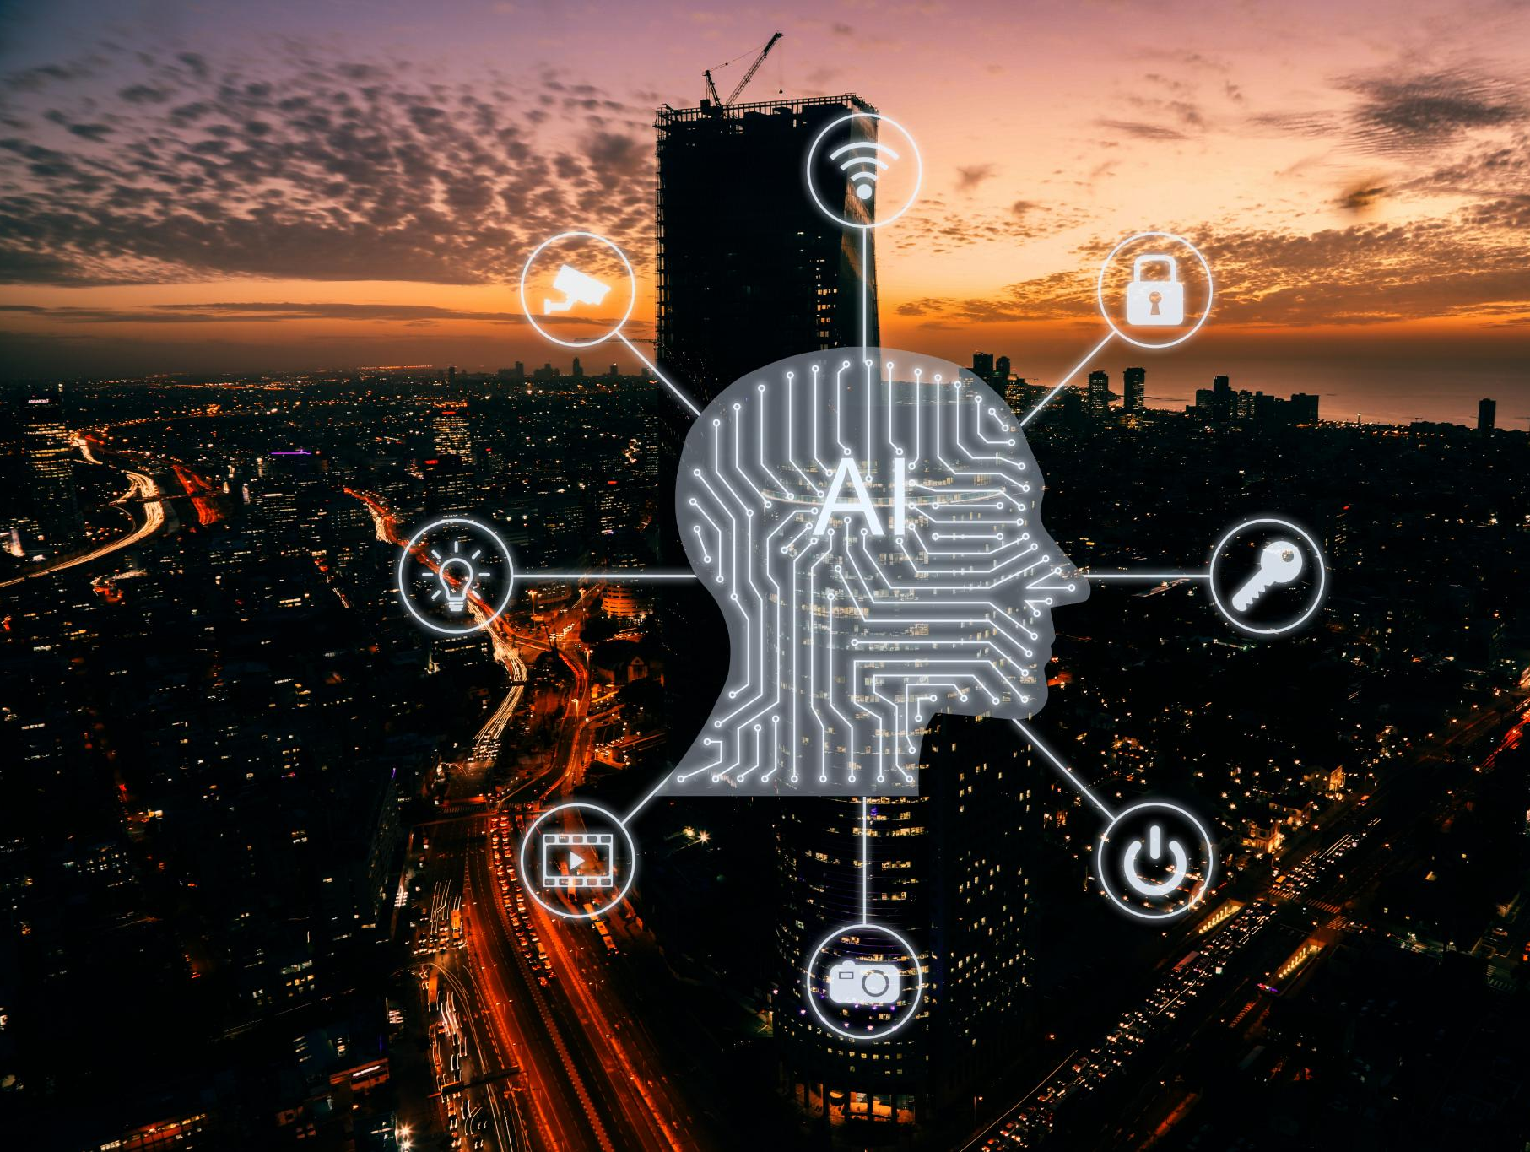
Shifts in Industry and Daily Life
Healthcare Transformation
AI revolutionizes healthcare by improving diagnostics, treatment plans, and patient care efficiency.
Finance Industry Evolution
AI optimizes financial services through automation, fraud detection, and personalized customer experiences.
Transportation Advancements
AI drives innovations in transportation including autonomous vehicles and smart traffic management systems.
Daily Life Integration
AI-powered devices enhance daily life conveniences through smart home and personal assistant technologies.
Notes:
Generated by Copilot AI is transforming industries like healthcare by improving diagnostics and treatment, finance through automation and fraud detection, and transportation with autonomous vehicles. Additionally, AI enhances daily life via smart devices, illustrating its pervasive influence across sectors. ______
Generated by Copilot AI is transforming industries like healthcare, finance, and transportation by improving diagnostics, automating services, and enabling innovations like autonomous vehicles. Additionally, AI-powered devices are becoming integral to daily life, enhancing convenience and connectivity. ______
--- Industries such as healthcare, finance, and transportation have been transformed by AI, while AI-powered devices increasingly influence everyday activities and conveniences. Image source: Microsoft 365 content library

Slide 18

Ethical Considerations and Societal Challenges
Privacy Concerns
AI technologies raise significant privacy issues related to data collection and usage without consent.
Bias in AI
AI systems can perpetuate or amplify bias, leading to unfair treatment in decision-making processes.
Accountability Issues
Determining who is responsible for AI decisions remains a major ethical challenge.
Societal Impact
Autonomous systems affect society broadly, raising concerns about employment, safety, and ethics.
Notes:
Generated by Copilot Ethical challenges include privacy issues from data use, biases embedded in AI systems leading to unfair outcomes, and accountability for AI decisions. These concerns underscore the need for responsible AI development and societal awareness of its broader implications. ______
Generated by Copilot Ethical challenges such as privacy, bias, and accountability are critical as AI systems become more pervasive. Addressing these issues is essential to ensure AI benefits society while mitigating risks related to fairness, responsibility, and societal impact. ______
--- The evolution of AI poses ethical dilemmas including privacy, bias, accountability, and the societal consequences of autonomous decision-making systems. Image source: Microsoft 365 content library

Slide 19
Current Trends and Future Transitions
Notes:
Generated by Copilot This section introduces current trends and future transitions in AI, preparing us to explore the latest advancements and the evolving landscape that will shape AI's role in society moving forward. ______
Generated by Copilot This section sets the stage for discussing current AI trends and future transitions, focusing on how ongoing advancements are shaping the next phase of AI development and its integration into society. ______
Looking forward, AI continues to advance rapidly with breakthroughs in generative models, autonomous systems, and ongoing debates about its future role and governance.

Slide 20

Advancements in Generative AI and Natural Language Processing
Generative AI Capabilities
Generative AI now produces creative outputs like text, images, and music with high quality and diversity.
Improved Human-Computer Interaction
Natural language processing advancements have greatly enhanced human-computer communication and usability.
Notes:
Generated by Copilot Generative AI now creates diverse and high-quality content such as text, images, and music, expanding creative possibilities. Advances in natural language processing have also improved how humans interact with machines, making communication more intuitive and effective. ______
Generated by Copilot Generative AI has advanced to create diverse and high-quality content, including text, images, and music. Improvements in natural language processing have significantly enhanced how humans interact with AI, making communication more intuitive and effective. ______
--- Recent progress in generative AI enables machines to create text, images, and music, while natural language processing has improved human-computer interactions dramatically. Image source: Microsoft 365 content library

Slide 21
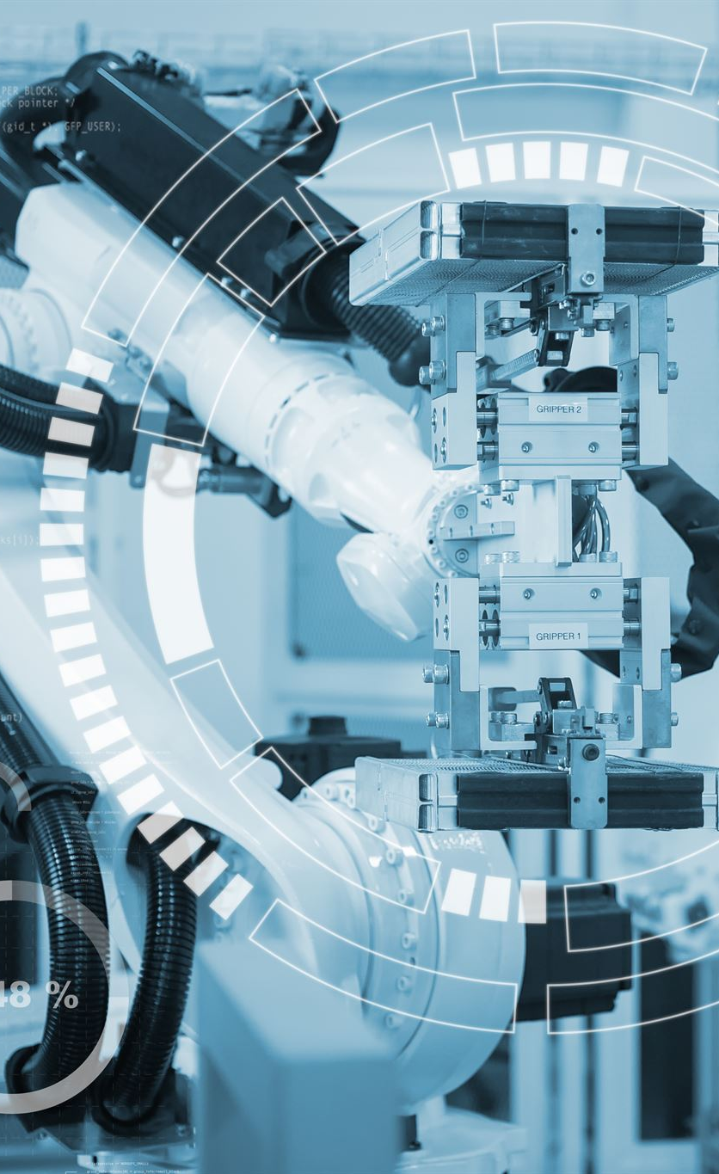
AI in Autonomous Systems and the Internet of Things
AI in Autonomous Vehicles
AI enables autonomous vehicles to navigate and make decisions, improving safety and efficiency on roads.
Robotics with AI
AI-powered robots enhance automation and perform complex tasks in various industries and environments.
Smart IoT Devices
AI integrated IoT devices enable smarter homes and cities through real-time data and connectivity.
Notes:
Generated by Copilot AI plays a crucial role in autonomous vehicles by enabling navigation and decision-making, enhancing road safety. Robotics powered by AI perform complex tasks across industries, while smart IoT devices use AI to create connected, intelligent environments in homes and cities. ______
Generated by Copilot AI's role in autonomous systems and IoT is expanding, with autonomous vehicles improving road safety, AI-powered robots enhancing automation, and smart IoT devices enabling intelligent environments in homes and cities through real-time data connectivity. ______
--- Integration of AI with autonomous vehicles, robotics, and IoT devices is creating smarter environments and new opportunities for automation and connectivity. Image source: Microsoft 365 content library

Slide 22
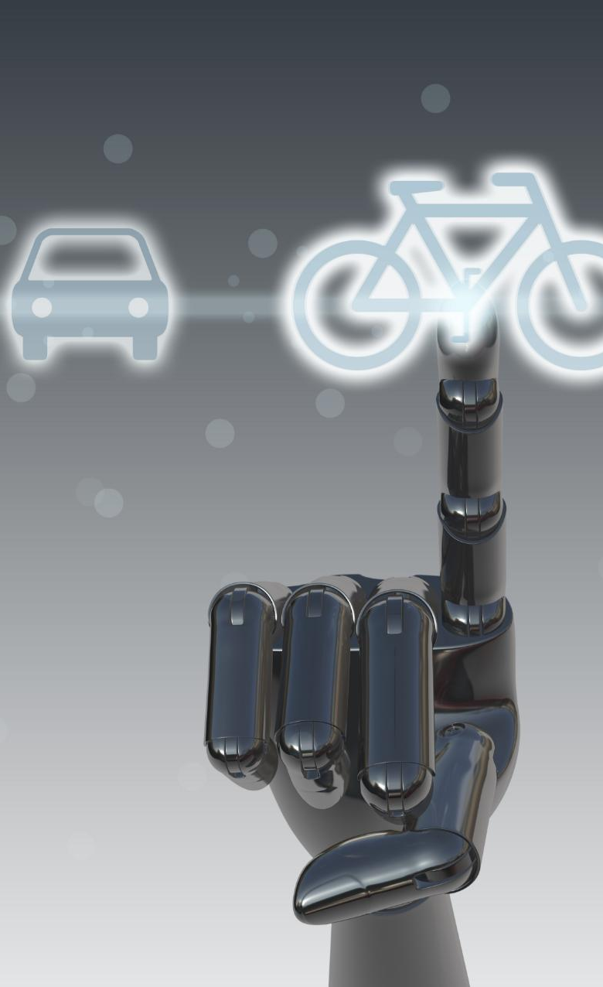
Predictions for the Future and Ongoing Debates
AI Innovation Opportunities
AI offers vast opportunities for innovation and advanced problem-solving across various industries.
Ethical Concerns and Control
Experts are concerned about ethical issues and maintaining control over AI development and deployment.
Human-Machine Intelligence Balance
Debates focus on achieving a balanced coexistence between human intelligence and machine intelligence.
Notes:
Generated by Copilot Looking ahead, AI offers vast innovation opportunities but also raises ethical concerns about control and responsibility. Ongoing debates focus on balancing human and machine intelligence to ensure AI benefits society while addressing potential risks. ______
Generated by Copilot Looking ahead, AI presents vast opportunities for innovation but also raises ethical concerns and debates about maintaining control. Balancing human and machine intelligence will be crucial to harness AI's benefits responsibly and sustainably. ______
--- Experts debate the future impact of AI, from opportunities in innovation and problem-solving to concerns about control, ethics, and the balance between human and machine intelligence. Image source: Microsoft 365 content library

Slide 23
Conclusion
AI Evolution Overview
AI development includes significant achievements and challenges shaping its current state and future.
Societal Impact
AI introduces societal shifts requiring awareness and adaptation to new technologies.
Future Preparedness
Understanding AI's journey enables preparation for its transformative potential and responsibilities.
Notes:
Generated by Copilot In conclusion, AI's evolution encompasses remarkable achievements and challenges that have shaped its current state. Understanding this journey helps us appreciate AI's societal impact and prepares us to responsibly harness its transformative potential in the future. ______
Generated by Copilot In conclusion, AI's evolution encompasses remarkable achievements and challenges that have shaped its current state. Understanding this journey helps us appreciate AI's societal impact and prepares us to responsibly embrace its transformative potential in the future. ______
The evolution of AI has been marked by remarkable achievements, challenges, and societal shifts. Understanding this journey helps us prepare for the transformative potential and responsibilities that AI brings to our world.

Slide 24

Connect with me: [LinkedIn] | [Email]

